Slide 1
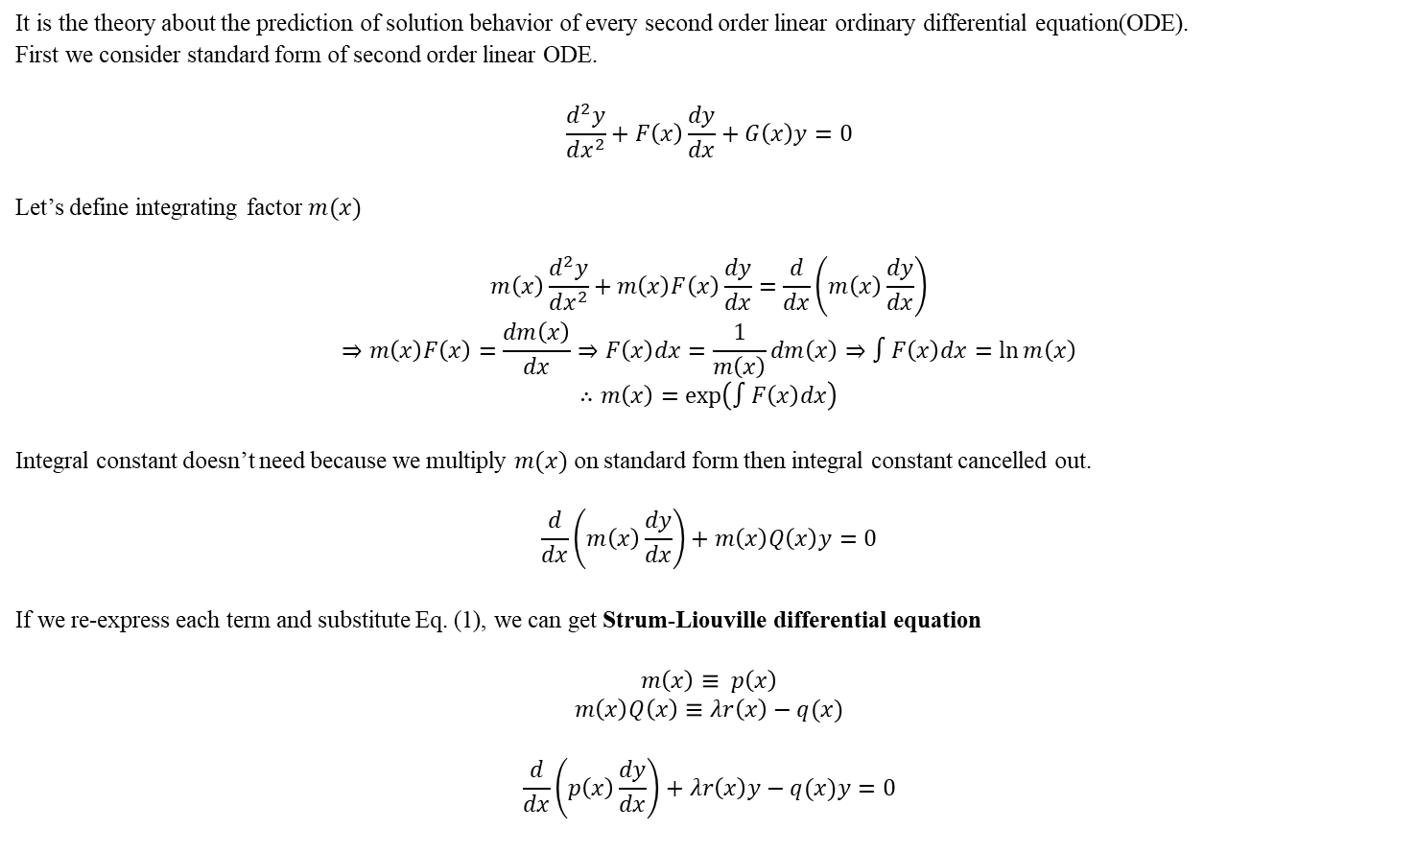
Strum-Liouville Theory
It is the theory about the prediction of solution behavior of every second order linear ordinary differential equation(ODE).
First we consider standard form of second order linear ODE.
$$\frac{d^{2}y}{dx^{2}}+F\left(x\right)\frac{dy}{dx}+G\left(x\right)y=0$$
Let’s define integrating factor $m(x)$
$$m\left(x\right)\frac{d^{2}y}{dx^{2}}+m\left(x\right)F\left(x\right)\frac{dy}{dx}=\frac{d}{dx}\left(m\left(x\right)\frac{dy}{dx}\right)$$
$$⇒m\left(x\right)F\left(x\right)=\frac{dm\left(x\right)}{dx}⇒F\left(x\right)dx=\frac{1}{m\left(x\right)}dm\left(x\right)⇒∫F\left(x\right)dx=\ln{m\left(x\right)}$$
$$∴m\left(x\right)=\exp\left(∫F\left(x\right)dx\right)$$
Integral constant doesn’t need because we multiply $m(x)$ on standard form then integral constant cancelled out.
$$\frac{d}{dx}\left(m\left(x\right)\frac{dy}{dx}\right)+m\left(x\right)Q\left(x\right)y=0$$
If we re-express each term and substitute Eq. (1), we can get Strum-Liouville differential equation
$$m\left(x\right)≡ p\left(x\right)$$
$$m\left(x\right)Q\left(x\right)≡λr\left(x\right)−q(x)$$
$$\frac{d}{dx}\left(p\left(x\right)\frac{dy}{dx}\right)+λr\left(x\right)y−q(x)y=0$$
(1)

Slide 2
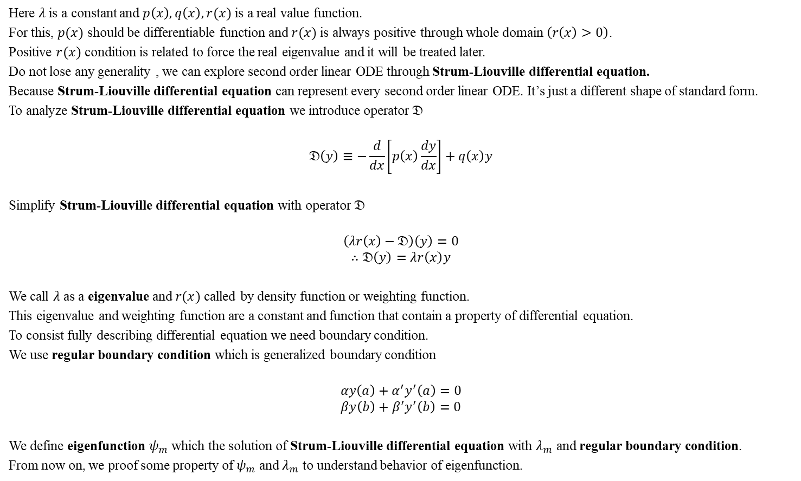
Strum-Liouville Theory
Here $λ$ is a constant and $p\left(x\right),q\left(x\right),r(x)$ is a real value function.
For this, $p(x)$ should be differentiable function and $r(x)$ is always positive through whole domain $\left(r\left(x\right)>0\right)$.
Positive $r(x)$ condition is related to force the real eigenvalue and it will be treated later.
Do not lose any generality , we can explore second order linear ODE through Strum-Liouville differential equation.
Because Strum-Liouville differential equation can represent every second order linear ODE. It’s just a different shape of standard form.
To analyze Strum-Liouville differential equation we introduce operator $𝔇$
$$𝔇\left(y\right)≡−\frac{d}{dx}\left[p\left(x\right)\frac{dy}{dx}\right]+q\left(x\right)y$$
Simplify Strum-Liouville differential equation with operator $𝔇$
$$\left(λr\left(x\right)−𝔇\right)\left(y\right)=0$$
$$∴𝔇\left(y\right)=λr\left(x\right)y$$
We call $λ$ as a eigenvalue and $r(x)$ called by density function or weighting function.
This eigenvalue and weighting function are a constant and function that contain a property of differential equation.
To consist fully describing differential equation we need boundary condition.
We use regular boundary condition which is generalized boundary condition
$$αy\left(a\right)+α^{′}y^{′}\left(a\right)=0$$
$$βy\left(b\right)+β^{′}y^{′}\left(b\right)=0$$
We define eigenfunction $ψ_{m}$ which the solution of Strum-Liouville differential equation with $λ_{m}$ and regular boundary condition.
From now on, we proof some property of $ψ_{m}$ and $λ_{m}$ to understand behavior of eigenfunction.

Slide 3

Self-adjointness
Self-adjointness
We consider two eigenfunction $ψ_{m}$ and $ψ_{n}$ which have same boundary condition.
Then following relation is always satisfied
$$\int_{a}^{b}{ψ_{m}\left(x\right)𝔇\left(ψ_{n}\left(x\right)\right)}dx=\int_{a}^{b}{ψ_{n}\left(x\right)𝔇\left(ψ_{m}\left(x\right)\right)}dx$$
[PF]
First we consider
$$ψ_{m}\left(x\right)𝔇\left(ψ_{n}\left(x\right)\right)−ψ_{n}\left(x\right)𝔇\left(ψ_{m}\left(x\right)\right)$$
From definition of operator $𝔇$
$$𝔇\left(ψ_{n}\left(x\right)\right)=−\frac{d}{dx}\left[p\left(x\right){ψ^{′}}_{n}\left(x\right)\right]+q\left(x\right)ψ_{n}\left(x\right)$$
Multiply $ψ_{m}$ and simplify it
$$ψ_{m}\left(x\right)𝔇\left(ψ_{n}\left(x\right)\right)=−ψ_{m}\left(x\right)\frac{d}{dx}\left[p\left(x\right){ψ^{′}}_{n}\left(x\right)\right]+ψ_{m}\left(x\right)q\left(x\right)ψ_{n}\left(x\right)$$
$$−ψ_{m}\left(x\right)\frac{d}{dx}\left[p\left(x\right){ψ^{′}}_{n}\left(x\right)\right]=−\frac{d}{dx}\left[p\left(x\right){ψ^{′}}_{n}\left(x\right)ψ_{m}\left(x\right)\right]+p\left(x\right){ψ^{′}}_{n}\left(x\right){ψ^{′}}_{m}\left(x\right)$$
$$⇒ ψ_{m}\left(x\right)𝔇\left(ψ_{n}\left(x\right)\right)=−\frac{d}{dx}\left[p\left(x\right){ψ^{′}}_{n}\left(x\right)ψ_{m}\left(x\right)\right]+p\left(x\right){ψ^{′}}_{n}\left(x\right){ψ^{′}}_{m}\left(x\right)+ψ_{m}\left(x\right)q\left(x\right)ψ_{n}\left(x\right)$$

Slide 4

Self-adjointness
In the same way
$$ψ_{n}\left(x\right)𝔇\left(ψ_{m}\left(x\right)\right)=−\frac{d}{dx}\left[p\left(x\right){ψ^{′}}_{m}\left(x\right)ψ_{n}\left(x\right)\right]+p\left(x\right){ψ^{′}}_{n}\left(x\right){ψ^{′}}_{m}\left(x\right)+ψ_{m}\left(x\right)q\left(x\right)ψ_{n}\left(x\right)$$
Using Wronskian $𝒲$
$$𝒲\left(u,v\right)=\left|\begin{matrix}u & v \\ u′ & v′\end{matrix}\right|=uv^{′}−u^{′}v$$
$$ψ_{m}\left(x\right)𝔇\left(ψ_{n}\left(x\right)\right)−ψ_{n}\left(x\right)𝔇\left(ψ_{m}\left(x\right)\right)=−\frac{d}{dx}\left[p\left(x\right)\left({ψ^{′}}_{n}\left(x\right)ψ_{m}\left(x\right)−{ψ^{′}}_{m}\left(x\right)ψ_{n}\left(x\right)\right)\right]=−\frac{d}{dx}\left[p\left(x\right)𝒲\left(ψ_{m}\left(x\right),ψ_{n}\left(x\right)\right)\right]$$
Eq. (2) is called Lagrange’s identity and it is always true regardless their boundary condition.
Integrate Eq. (2) $a$ to $b$
$$\int_{a}^{b}{ψ_{m}\left(x\right)𝔇\left(ψ_{n}\left(x\right)\right)−ψ_{n}\left(x\right)𝔇\left(ψ_{m}\left(x\right)\right)}dx=\int_{a}^{b}{−\frac{d}{dx}\left[p\left(x\right)𝒲\left(ψ_{m}\left(x\right),ψ_{n}\left(x\right)\right)\right]}dx$$
$$\int_{a}^{b}{−\frac{d}{dx}\left[p\left(x\right)𝒲\left(ψ_{m}\left(x\right),ψ_{n}\left(x\right)\right)\right]}dx=p\left(a\right)𝒲\left(ψ_{m}\left(a\right),ψ_{n}\left(a\right)\right)−p\left(b\right)𝒲\left(ψ_{m}\left(b\right),ψ_{n}\left(b\right)\right)$$
(2)
(3)

Slide 5
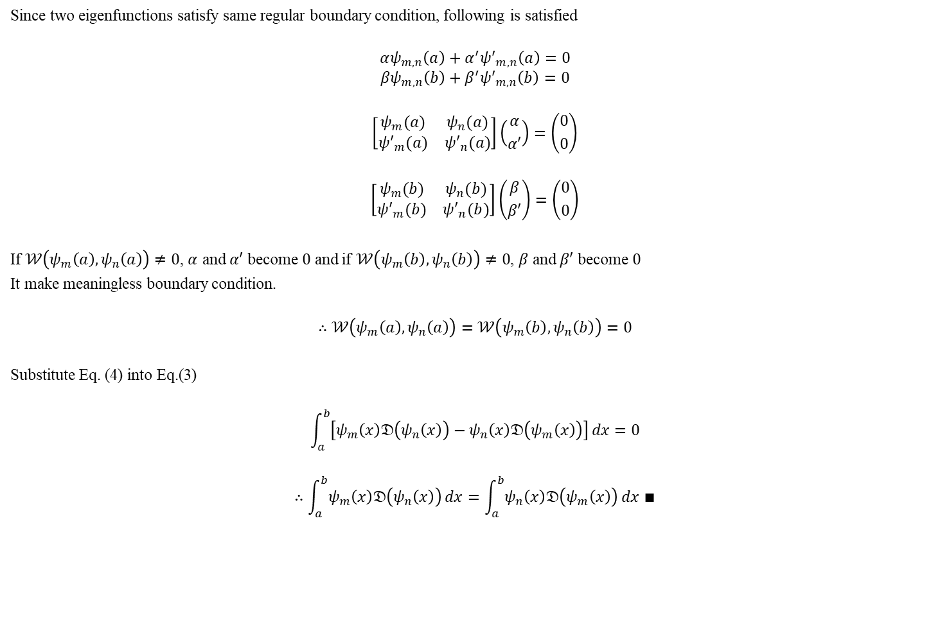
Self-adjointness
Since two eigenfunctions satisfy same regular boundary condition, following is satisfied
$$αψ_{m,n}\left(a\right)+α^{′}{ψ′}_{m,n}\left(a\right)=0$$
$$βψ_{m,n}\left(b\right)+β^{′}{ψ′}_{m,n}\left(b\right)=0$$
$$\left[\begin{matrix}ψ_{m}(a) & ψ_{n}(a) \\ {ψ′}_{m}(a) & {ψ′}_{n}(a)\end{matrix}\right]\left({α \atop α′}\right)=\left({0 \atop 0}\right)$$
$$\left[\begin{matrix}ψ_{m}(b) & ψ_{n}(b) \\ {ψ′}_{m}(b) & {ψ′}_{n}(b)\end{matrix}\right]\left({β \atop β′}\right)=\left({0 \atop 0}\right)$$
If $𝒲\left(ψ_{m}\left(a\right),ψ_{n}\left(a\right)\right)≠0$, $α$ and $α′$ become $0$ and if $𝒲\left(ψ_{m}\left(b\right),ψ_{n}\left(b\right)\right)≠0$, $β$ and $β′$ become $0$
It make meaningless boundary condition.
$$∴𝒲\left(ψ_{m}\left(a\right),ψ_{n}\left(a\right)\right)=𝒲\left(ψ_{m}\left(b\right),ψ_{n}\left(b\right)\right)=0$$
Substitute Eq. (4) into Eq.(3)
$$\int_{a}^{b}{\left[ψ_{m}\left(x\right)𝔇\left(ψ_{n}\left(x\right)\right)−ψ_{n}\left(x\right)𝔇\left(ψ_{m}\left(x\right)\right)\right]}dx=0$$
$$∴\int_{a}^{b}{ψ_{m}\left(x\right)𝔇\left(ψ_{n}\left(x\right)\right)}dx=\int_{a}^{b}{ψ_{n}\left(x\right)𝔇\left(ψ_{m}\left(x\right)\right)}dx ∎$$
(4)
(5)

Slide 6

Orthogonality
Orthogonality
We consider two eigenfunctions $ψ_{m}$ and $ψ_{n}$ which have same boundary condition.
Then following relation is always satisfied
$$\int_{a}^{b}{ψ_{m}\left(x\right)ψ_{n}\left(x\right)r(x)}dx=0 ,when m≠n$$
[PF]
First we consider
$$ψ_{m}\left(x\right)𝔇\left(ψ_{n}\left(x\right)\right)−ψ_{n}\left(x\right)𝔇\left(ψ_{m}\left(x\right)\right)$$
From relation of operator $𝔇$
$$ψ_{m}\left(x\right)𝔇\left(ψ_{n}\left(x\right)\right)−ψ_{n}\left(x\right)𝔇\left(ψ_{m}\left(x\right)\right)=\left(λ_{n}−λ_{m}\right)ψ_{m}\left(x\right)ψ_{n}\left(x\right)r(x)$$
Integrate Eq. (6) $a$ to $b$
$$\int_{a}^{b}{ψ_{m}\left(x\right)𝔇\left(ψ_{n}\left(x\right)\right)−ψ_{n}\left(x\right)𝔇\left(ψ_{m}\left(x\right)\right)}dx=\int_{a}^{b}{\left(λ_{n}−λ_{m}\right)ψ_{m}\left(x\right)ψ_{n}\left(x\right)r(x)}dx$$
(6)

Slide 7
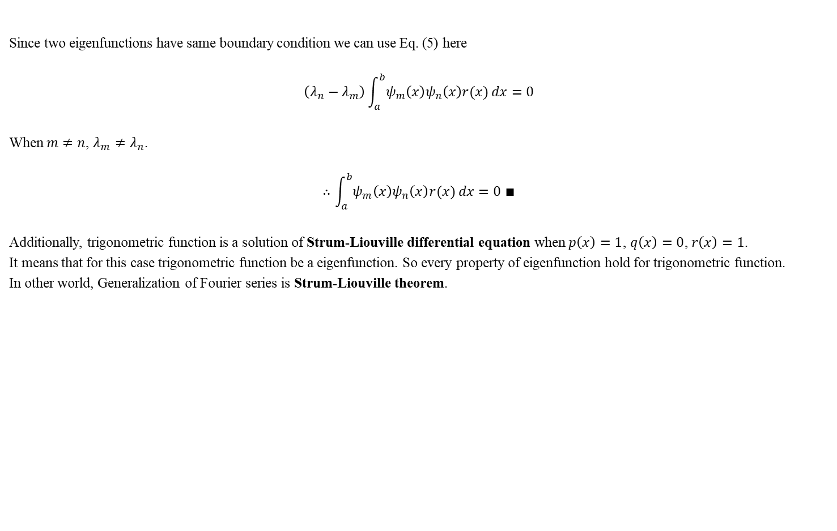
Orthogonality
Since two eigenfunctions have same boundary condition we can use Eq. (5) here
$$\left(λ_{n}−λ_{m}\right)\int_{a}^{b}{ψ_{m}\left(x\right)ψ_{n}\left(x\right)r(x)}dx=0$$
When $m≠n$, $λ_{m}≠λ_{n}$.
$$∴\int_{a}^{b}{ψ_{m}\left(x\right)ψ_{n}\left(x\right)r(x)}dx=0 ∎$$
Additionally, trigonometric function is a solution of Strum-Liouville differential equation when $p\left(x\right)=1$, $q\left(x\right)=0$, $r\left(x\right)=1$.
It means that for this case trigonometric function be a eigenfunction. So every property of eigenfunction hold for trigonometric function.
In other world, Generalization of Fourier series is Strum-Liouville theorem.
(7)

Slide 8

Real Eigenvalue
Real eigenvalue
We consider two eigenfunctions $ψ_{m}$ and $ψ_{m}^{∗}$ which is complex conjugate of $ψ_{m}$ and assume that both of them satisfy same boundary condition.
Then following relation is always satisfied
$$Im\left(λ_{m}\right)=0$$
[PF]
Since both of eigenfunctions are satisfy same boundary condition, we can use Eq. (7) directly
$$\left(λ_{m}−λ_{m}^{∗}\right)\int_{a}^{b}{ψ_{m}\left(x\right)ψ_{m}^{∗}\left(x\right)r(x)}dx=\left(λ_{m}−λ_{m}^{∗}\right)\int_{a}^{b}{{\left|ψ_{m}\left(x\right)\right|}^{2} r(x)}dx=0$$
If we assume $r\left(x\right)>0$ integral result must be positive value and it leads that $λ_{m}−λ_{m}^{∗}=0$
It means $λ_{m}$ is real.
$$∴Im\left(λ_{m}\right)=0 ∎$$
Additionally, to satisfy the assumption we need another condition and details in Appendix 1.

Slide 9

Constant Wronskian (Abel’s Theorem)
Constant Wronskian (Abel’s theorem)
We consider two eigenfunction $ψ_{m}$ and $ψ_{n}$.
Then following relation is always satisfied
$$p\left(x\right)𝒲\left(ψ_{m}\left(x\right),ψ_{n}\left(x\right)\right)=constant ,when λ_{m}=λ_{n}$$
[PF]
we can use Eq. (2) and Eq.(6) which hold true regardless of same boundary condition assumption
$$−\frac{d}{dx}\left[p\left(x\right)𝒲\left(ψ_{m}\left(x\right),ψ_{n}\left(x\right)\right)\right]=\left(λ_{n}−λ_{m}\right)ψ_{m}\left(x\right)ψ_{n}\left(x\right)r(x)$$
When $λ_{m}=λ_{n}$
$$−\frac{d}{dx}\left[p\left(x\right)𝒲\left(ψ_{m}\left(x\right),ψ_{n}\left(x\right)\right)\right]=0$$
Take indefinite integral
$$p\left(x\right)𝒲\left(ψ_{m}\left(x\right),ψ_{n}\left(x\right)\right)=constant ∎$$

Slide 10

Uniqueness of Solutions
Uniqueness of solutions
We consider two distinct eigenfunctions $ψ_{1}$ and $ψ_{2}$ which have same eigenvalue $λ$ and have same boundary condition(BC).
Then following relation is always satisfied with some constant $c$
$$ψ_{1}=cψ_{2} ,when λ_{1}=λ_{2}$$
[PF]
Since eigenfunctions have same eigenvalue, we can use Abel’s theorem here
$$p\left(x\right)𝒲\left(ψ_{1}\left(x\right),ψ_{2}\left(x\right)\right)=constant$$
We can use Eq. (4) because eigenfunctions have same BC.
Substitute Eq. (4) into Abel’s theorem
$$p\left(x\right)𝒲\left(ψ_{1}\left(x\right),ψ_{2}\left(x\right)\right)=0$$
$$⇒\frac{ψ_{1}\left(x\right)}{{ψ′}_{1}\left(x\right)}=\frac{ψ_{2}\left(x\right)}{{ψ′}_{2}\left(x\right)}$$
if $ψ_{1}\left(x\right)=f\left(x\right)ψ_{2}(x)$
$$\frac{f\left(x\right)ψ_{2}(x) }{f′\left(x\right)ψ_{2}(x)+f\left(x\right){ψ′}_{2}(x)}≠\frac{ψ_{2}\left(x\right)}{{ψ′}_{2}\left(x\right)}$$

Slide 11

Uniqueness of Solutions
if $ψ_{1}\left(x\right)=cψ_{2}(x)$
$$\frac{cψ_{2}(x) }{c{ψ′}_{2}(x)}=\frac{ψ_{2}\left(x\right)}{{ψ′}_{2}\left(x\right)}$$
$$∴ψ_{1}=cψ_{2} ,when λ_{1}=λ_{2} ∎$$
It means that when eigenfunctions have same eigenvalue and same BC, $λ$ and $cψ(x)$ is one to one correspondence.

Slide 12
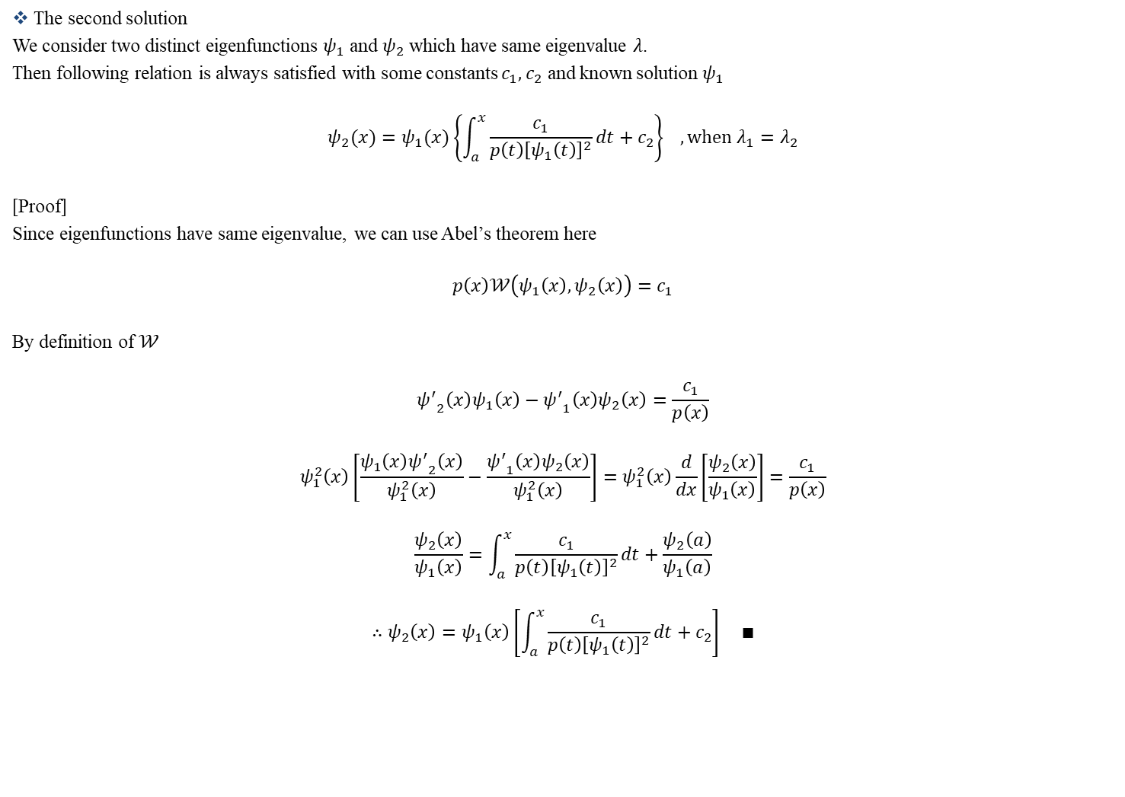
The Second Solution
The second solution
We consider two distinct eigenfunctions $ψ_{1}$ and $ψ_{2}$ which have same eigenvalue $λ$.
Then following relation is always satisfied with some constants $c_{1},c_{2}$ and known solution $ψ_{1}$
$$ψ_{2}(x)=ψ_{1}(x)\left\{\int_{a}^{x}{\frac{c_{1}}{p\left(t\right){\left[ψ_{1}\left(t\right)\right]}^{2}}}dt+c_{2}\right\} ,when λ_{1}=λ_{2}$$
[Proof]
Since eigenfunctions have same eigenvalue, we can use Abel’s theorem here
$$p\left(x\right)𝒲\left(ψ_{1}\left(x\right),ψ_{2}\left(x\right)\right)=c_{1}$$
By definition of $𝒲$
$${ψ^{′}}_{2}\left(x\right)ψ_{1}\left(x\right)−{ψ^{′}}_{1}\left(x\right)ψ_{2}\left(x\right)=\frac{c_{1}}{p\left(x\right)}$$
$$ψ_{1}^{2}\left(x\right)\left[\frac{ψ_{1}\left(x\right){ψ^{′}}_{2}\left(x\right)}{ψ_{1}^{2}\left(x\right)}−\frac{{ψ^{′}}_{1}\left(x\right)ψ_{2}\left(x\right)}{ψ_{1}^{2}\left(x\right)}\right]=ψ_{1}^{2}\left(x\right)\frac{d}{dx}\left[\frac{ψ_{2}\left(x\right)}{ψ_{1}\left(x\right)}\right]=\frac{c_{1}}{p\left(x\right)}$$
$$\frac{ψ_{2}\left(x\right)}{ψ_{1}\left(x\right)}=\int_{a}^{x}{\frac{c_{1}}{p\left(t\right){\left[ψ_{1}\left(t\right)\right]}^{2}}}dt+\frac{ψ_{2}\left(a\right)}{ψ_{1}\left(a\right)}$$
$$∴ψ_{2}\left(x\right)=ψ_{1}\left(x\right)\left[\int_{a}^{x}{\frac{c_{1}}{p\left(t\right){\left[ψ_{1}\left(t\right)\right]}^{2}}}dt+c_{2}\right] ∎$$

Slide 13

Rayleigh Quotient
Rayleigh quotient
We consider eigenfunctions $ψ_{m}(x)$ and corresponding eigenvalue $λ_{m}$.
If we define inner product operator
$$\left\langle f(x),g(x)\right\rangle =\int_{a}^{b}{f^{∗}\left(x\right)g\left(x\right)r\left(x\right)}dx$$
Then following relation is always satisfied
$$λ_{m}=\frac{\left\langle ψ_{m},\frac{𝔇\left(ψ_{m}\right)}{r\left(x\right)}\right\rangle }{\left\langle ψ_{m},ψ_{m}\right\rangle }$$
[Proof]
From relation of operator $𝔇$
$$𝔇\left(ψ_{m}\right)=λ_{m}r\left(x\right)ψ_{m}$$
Multiply $ψ_{m}^{∗}(x)$ and integrate it over $a$ to $b$
$$λ_{m}r\left(x\right)ψ_{m}ψ_{m}^{∗}=ψ_{m}^{∗}𝔇\left(ψ_{m}\right)$$
$$λ_{m}\int_{a}^{b}{r\left(x\right)ψ_{m}ψ_{m}^{∗}}dx=\int_{a}^{b}{ψ_{m}^{∗}\frac{𝔇\left(ψ_{m}\right)}{r\left(x\right)}r\left(x\right)}dx$$

Slide 14
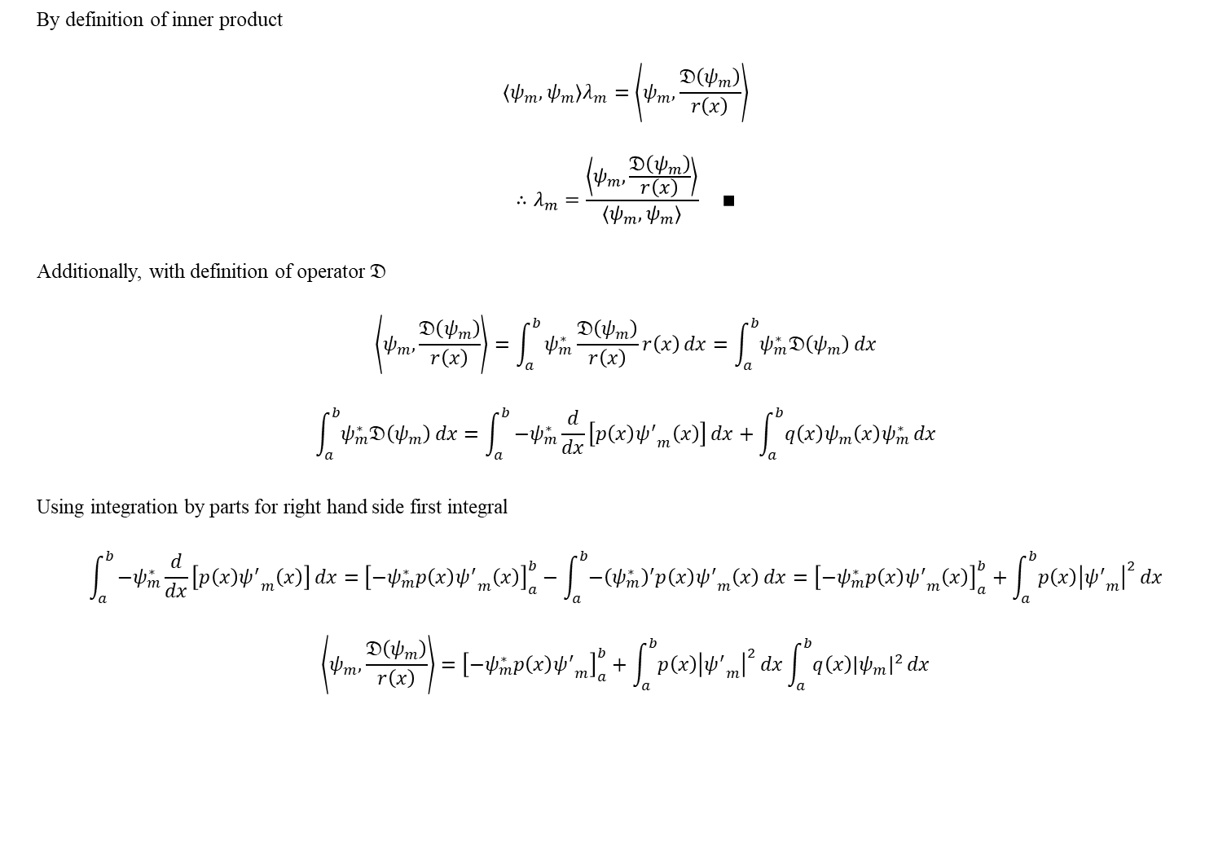
Rayleigh Quotient
By definition of inner product
$$\left\langle ψ_{m},ψ_{m}\right\rangle λ_{m}=\left\langle ψ_{m},\frac{𝔇\left(ψ_{m}\right)}{r\left(x\right)}\right\rangle$$
$$∴λ_{m}=\frac{\left\langle ψ_{m},\frac{𝔇\left(ψ_{m}\right)}{r\left(x\right)}\right\rangle }{\left\langle ψ_{m},ψ_{m}\right\rangle } ∎$$
Additionally, with definition of operator $𝔇$
$$\left\langle ψ_{m},\frac{𝔇\left(ψ_{m}\right)}{r\left(x\right)}\right\rangle =\int_{a}^{b}{ψ_{m}^{∗}\frac{𝔇\left(ψ_{m}\right)}{r\left(x\right)}r\left(x\right)}dx=\int_{a}^{b}{ψ_{m}^{∗}𝔇\left(ψ_{m}\right)}dx$$
$$\int_{a}^{b}{ψ_{m}^{∗}𝔇\left(ψ_{m}\right)}dx=\int_{a}^{b}{−ψ_{m}^{∗}\frac{d}{dx}\left[p\left(x\right){ψ^{′}}_{m}\left(x\right)\right]}dx+\int_{a}^{b}{q\left(x\right)ψ_{m}\left(x\right)ψ_{m}^{∗}}dx$$
Using integration by parts for right hand side first integral
$$\int_{a}^{b}{−ψ_{m}^{∗}\frac{d}{dx}\left[p\left(x\right){ψ^{′}}_{m}\left(x\right)\right]}dx={\left[−ψ_{m}^{∗}p\left(x\right){ψ^{′}}_{m}\left(x\right)\right]}_{a}^{b}−\int_{a}^{b}{−{\left(ψ_{m}^{∗}\right)}^{′}p\left(x\right){ψ^{′}}_{m}\left(x\right)}dx={\left[−ψ_{m}^{∗}p\left(x\right){ψ^{′}}_{m}\left(x\right)\right]}_{a}^{b}+\int_{a}^{b}{p\left(x\right){\left|{ψ^{′}}_{m}\right|}^{2}}dx$$
$$\left\langle ψ_{m},\frac{𝔇\left(ψ_{m}\right)}{r\left(x\right)}\right\rangle ={\left[−ψ_{m}^{∗}p\left(x\right){ψ^{′}}_{m}\right]}_{a}^{b}+\int_{a}^{b}{p\left(x\right){\left|{ψ^{′}}_{m}\right|}^{2}}dx\int_{a}^{b}{q\left(x\right){\left|ψ_{m}\right|}^{2}}dx$$

Slide 15

Rayleigh Quotient
Sum up all the relation
$$λ_{m}=\frac{\left\langle ψ_{m},\frac{𝔇\left(ψ_{m}\right)}{r\left(x\right)}\right\rangle }{\left\langle ψ_{m},ψ_{m}\right\rangle }=\frac{{\left[−ψ_{m}^{∗}p\left(x\right){ψ^{′}}_{m}\right]}_{a}^{b}+\int_{a}^{b}{p\left(x\right){\left|{ψ^{′}}_{m}\right|}^{2}}dx\int_{a}^{b}{q\left(x\right){\left|ψ_{m}\right|}^{2}}dx}{\int_{a}^{b}{r\left(x\right){\left|ψ_{m}\right|}^{2}}dx}$$
It is useful tool when we calculate eigenvalue.

Slide 16

Strum’s Separation Theorem
It is the theorem that consist of three propositions
1. Zero points of eigenfunction are finite
2. Eigenfunction have simple root near the zero points
3. For two independent eigenfunctions $ψ_{1}$, $ψ_{2}$ which have same eigenvalue $λ$, zero point of $ψ_{2}$ must exist between zero points of $ψ_{1}$
All the propositions are about zero points.
The reason for this is zero points can show us the oscillation property of eigenfunction.
Proof of propositions follow.

Slide 17
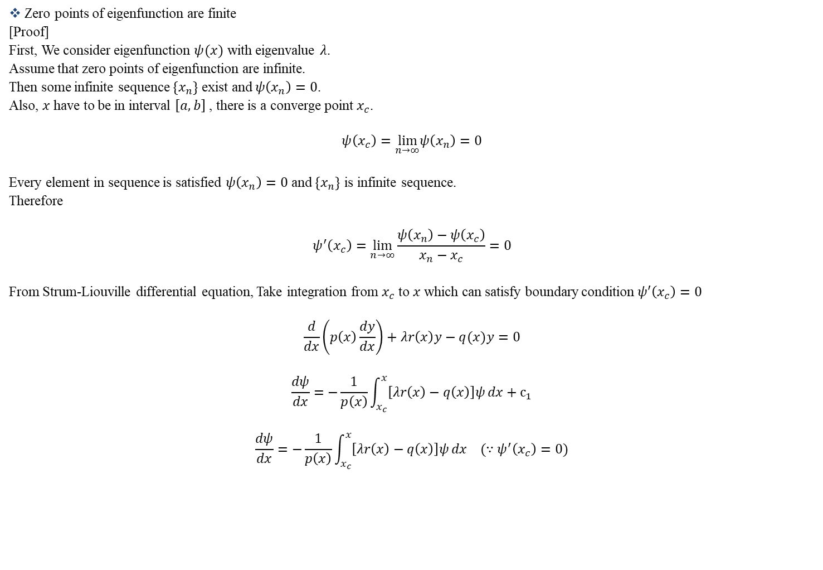
Strum’s Separation Theorem
Zero points of eigenfunction are finite
[Proof]
First, We consider eigenfunction $ψ(x)$ with eigenvalue $λ$.
Assume that zero points of eigenfunction are infinite.
Then some infinite sequence $\{x_{n}\}$ exist and $ψ\left(x_{n}\right)=0$.
Also, $x$ have to be in interval $\left[a,b\right]$ , there is a converge point $x_{c}$.
$$ψ\left(x_{c}\right)=\lim_{n→∞}ψ\left(x_{n}\right)=0$$
Every element in sequence is satisfied $ψ\left(x_{n}\right)=0$ and $\{x_{n}\}$ is infinite sequence.
Therefore
$$ψ^{′}\left(x_{c}\right)=\lim_{n→∞}\frac{ψ\left(x_{n}\right)−ψ\left(x_{c}\right)}{x_{n}−x_{c}}=0$$
From Strum-Liouville differential equation, Take integration from $x_{c}$ to $x$ which can satisfy boundary condition $ψ′\left(x_{c}\right)=0$
$$\frac{d}{dx}\left(p\left(x\right)\frac{dy}{dx}\right)+λr\left(x\right)y−q(x)y=0$$
$$\frac{dψ}{dx}=−\frac{1}{p\left(x\right)}\int_{x_{c}}^{x}{\left[λr\left(x\right)−q\left(x\right)\right]ψ}dx+c_{1}$$
$$\frac{dψ}{dx}=−\frac{1}{p\left(x\right)}\int_{x_{c}}^{x}{\left[λr\left(x\right)−q\left(x\right)\right]ψ}dx (∵ψ^{′}\left(x_{c}\right)=0)$$

Slide 18

Strum’s Separation Theorem
Using Picard’s iteration method with starting point $x_{c}$
Then $ψ^{0}=ψ\left(x_{c}\right)=0$
$$\frac{dψ^{1}}{dx}=−\frac{1}{p\left(x\right)}\int_{x_{c}}^{x}{\left[λr\left(x\right)−q\left(x\right)\right]ψ^{0}}dx$$
$$\frac{dψ^{1}}{dx}=−\frac{ψ^{0}}{p\left(x\right)}\int_{x_{c}}^{x}{\left[λr\left(x\right)−q\left(x\right)\right]}dx$$
$$⇒\frac{dψ^{1}}{dx}=0$$
Take integration from $x_{c}$ to $x$ which satisfy boundary condition $ψ\left(x_{c}\right)=0$
$$ψ^{1}\left(x\right)−ψ^{1}\left(x_{c}\right)=0$$
$$∴ψ^{1}\left(x\right)=ψ^{1}\left(x_{c}\right)=0$$
Following this step, readily to know that iteration is converge to $ψ\left(x\right)=0$
It is meaningless solution.
Therefore zero points of eigenfunction must be finite. $∎$

Slide 19
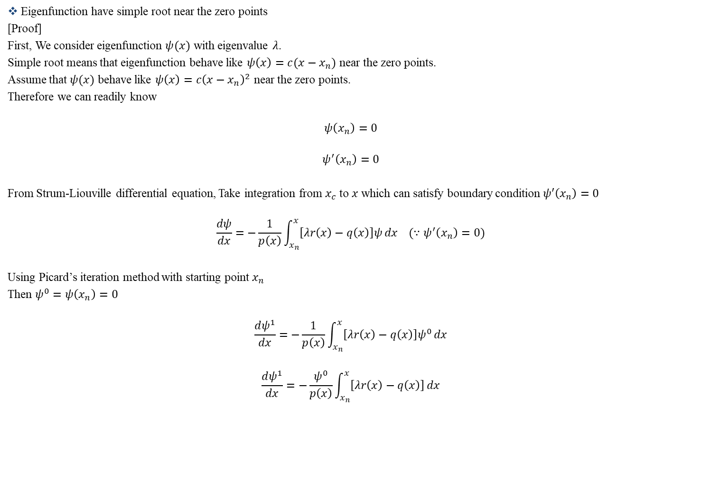
Strum’s Separation Theorem
Eigenfunction have simple root near the zero points
[Proof]
First, We consider eigenfunction $ψ(x)$ with eigenvalue $λ$.
Simple root means that eigenfunction behave like $ψ\left(x\right)=c(x−x_{n})$ near the zero points.
Assume that $ψ(x)$ behave like $ψ\left(x\right)=c{\left(x−x_{n}\right)}^{2}$ near the zero points.
Therefore we can readily know
$$ψ\left(x_{n}\right)=0$$
$$ψ^{′}\left(x_{n}\right)=0$$
From Strum-Liouville differential equation, Take integration from $x_{c}$ to $x$ which can satisfy boundary condition $ψ′\left(x_{n}\right)=0$
$$\frac{dψ}{dx}=−\frac{1}{p\left(x\right)}\int_{x_{n}}^{x}{\left[λr\left(x\right)−q\left(x\right)\right]ψ}dx (∵ψ^{′}\left(x_{n}\right)=0)$$
Using Picard’s iteration method with starting point $x_{n}$
Then $ψ^{0}=ψ\left(x_{n}\right)=0$
$$\frac{dψ^{1}}{dx}=−\frac{1}{p\left(x\right)}\int_{x_{n}}^{x}{\left[λr\left(x\right)−q\left(x\right)\right]ψ^{0}}dx$$
$$\frac{dψ^{1}}{dx}=−\frac{ψ^{0}}{p\left(x\right)}\int_{x_{n}}^{x}{\left[λr\left(x\right)−q\left(x\right)\right]}dx$$

Slide 20

Strum’s Separation Theorem
$$⇒\frac{dψ^{1}}{dx}=0$$
Take integration from $x_{n}$ to $x$ which satisfy boundary condition $ψ\left(x_{n}\right)=0$
$$ψ^{1}\left(x\right)−ψ^{1}\left(x_{n}\right)=0$$
$$∴ψ^{1}\left(x\right)=ψ^{1}\left(x_{n}\right)=0$$
Following this procedure, we can easily know that iteration is converge to $ψ\left(x\right)=0$
It is meaningless solution.
Therefore eigenfunction have simple root near the zero points. $∎$

Slide 21
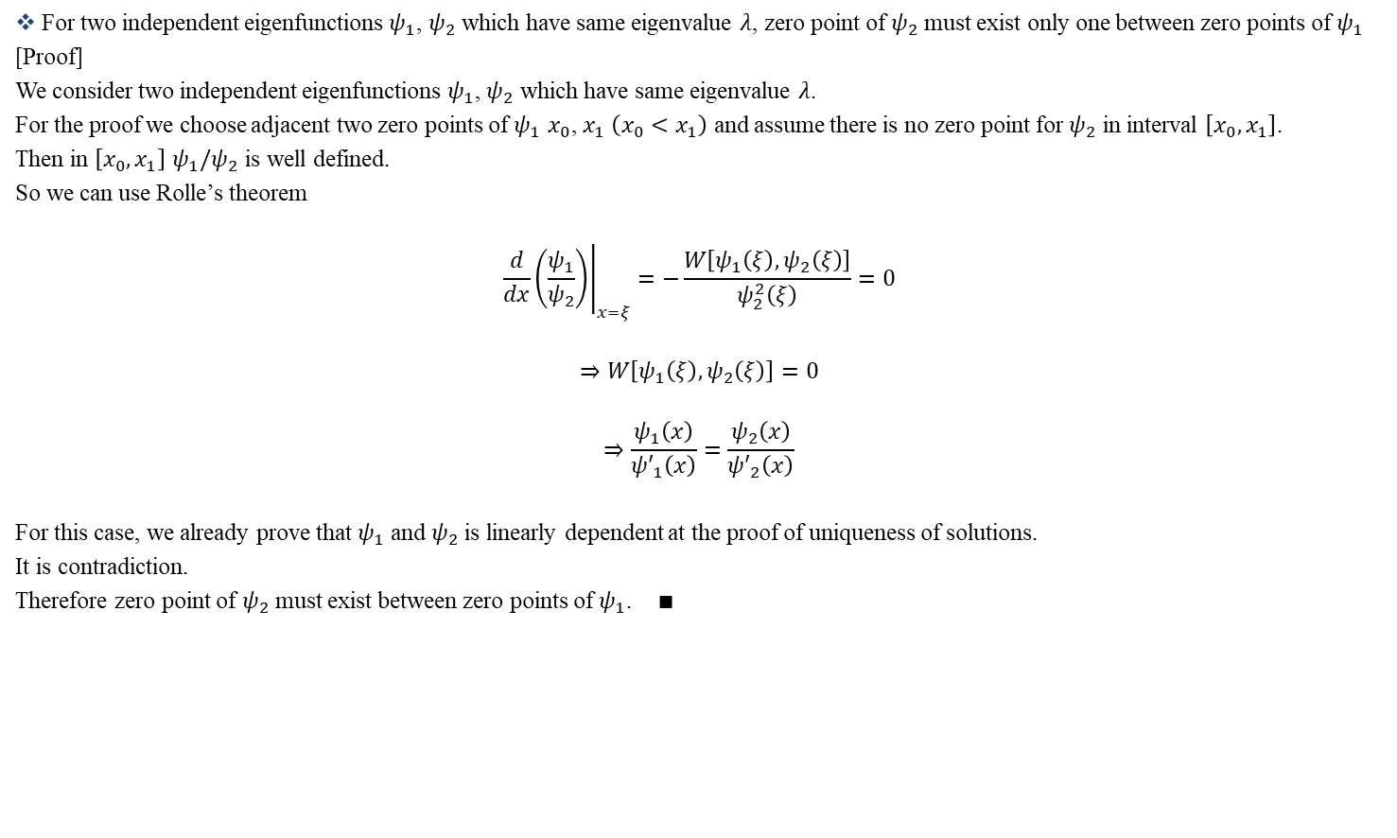
Strum’s Separation Theorem
For two independent eigenfunctions $ψ_{1}$, $ψ_{2}$ which have same eigenvalue $λ$, zero point of $ψ_{2}$ must exist only one between zero points of $ψ_{1}$
[Proof]
We consider two independent eigenfunctions $ψ_{1}$, $ψ_{2}$ which have same eigenvalue $λ$.
For the proof we choose adjacent two zero points of $ψ_{1}$ $x_{0}$, $x_{1}$ $\left(x_{0}<x_{1}\right)$ and assume there is no zero point for $ψ_{2}$ in interval $\left[x_{0},x_{1}\right]$.
Then in $\left[x_{0},x_{1}\right]$ $ψ_{1}/ψ_{2}$ is well defined.
So we can use Rolle’s theorem
$${\left.\frac{d}{dx}\left(\frac{ψ_{1}}{ψ_{2}}\right)\right|}_{x=ξ}=−\frac{W\left[ψ_{1}\left(ξ\right),ψ_{2}\left(ξ\right)\right]}{ψ_{2}^{2}\left(ξ\right)}=0$$
$$⇒W\left[ψ_{1}\left(ξ\right),ψ_{2}\left(ξ\right)\right]=0$$
$$⇒\frac{ψ_{1}\left(x\right)}{{ψ′}_{1}\left(x\right)}=\frac{ψ_{2}\left(x\right)}{{ψ′}_{2}\left(x\right)}$$
For this case, we already prove that $ψ_{1}$ and $ψ_{2}$ is linearly dependent at the proof of uniqueness of solutions.
It is contradiction.
Therefore zero point of $ψ_{2}$ must exist between zero points of $ψ_{1}$. $∎$

Slide 22
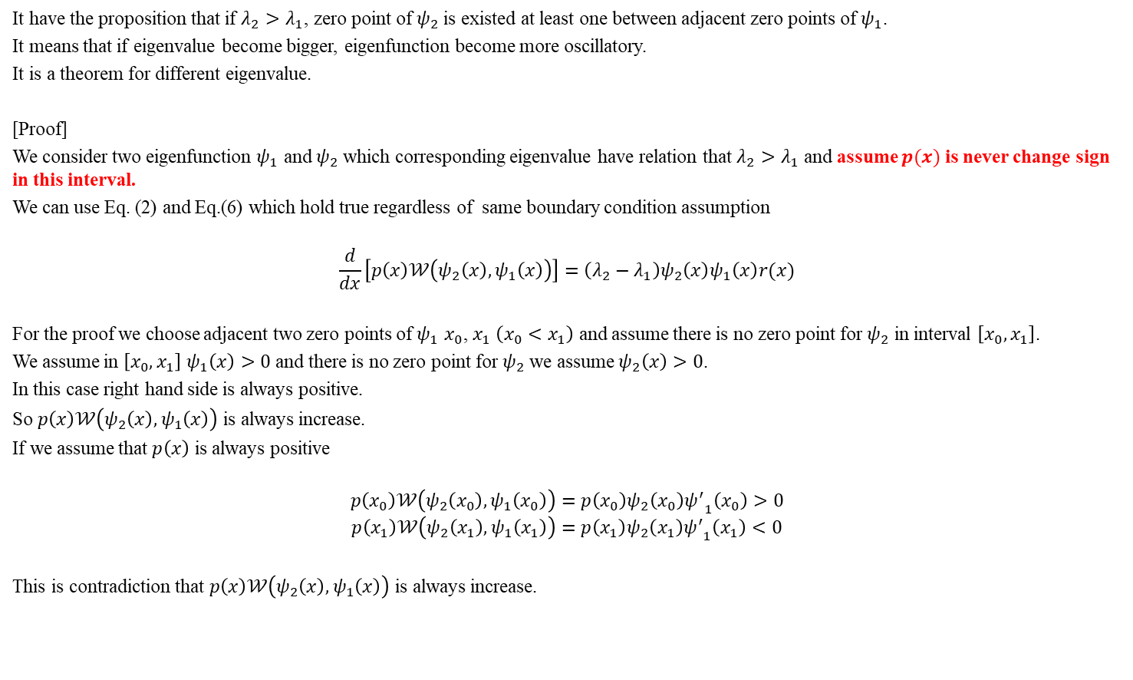
Strum’s Comparison Theorem
It have the proposition that if $λ_{2}>λ_{1}$, zero point of $ψ_{2}$ is existed at least one between adjacent zero points of $ψ_{1}$.
It means that if eigenvalue become bigger, eigenfunction become more oscillatory.
It is a theorem for different eigenvalue.
[Proof]
We consider two eigenfunction $ψ_{1}$ and $ψ_{2}$ which corresponding eigenvalue have relation that $λ_{2}>λ_{1}$ and assume $p(x)$ is never change sign in this interval.
We can use Eq. (2) and Eq.(6) which hold true regardless of same boundary condition assumption
$$\frac{d}{dx}\left[p\left(x\right)𝒲\left(ψ_{2}\left(x\right),ψ_{1}\left(x\right)\right)\right]=\left(λ_{2}−λ_{1}\right)ψ_{2}\left(x\right)ψ_{1}\left(x\right)r(x)$$
For the proof we choose adjacent two zero points of $ψ_{1}$ $x_{0}$, $x_{1}$ $\left(x_{0}<x_{1}\right)$ and assume there is no zero point for $ψ_{2}$ in interval $\left[x_{0},x_{1}\right]$.
We assume in $\left[x_{0},x_{1}\right]$ $ψ_{1}\left(x\right)>0$ and there is no zero point for $ψ_{2}$ we assume $ψ_{2}\left(x\right)>0$.
In this case right hand side is always positive.
So $p\left(x\right)𝒲\left(ψ_{2}\left(x\right),ψ_{1}\left(x\right)\right)$ is always increase.
If we assume that $p\left(x\right)$ is always positive
$$p\left(x_{0}\right)𝒲\left(ψ_{2}\left(x_{0}\right),ψ_{1}\left(x_{0}\right)\right)=p\left(x_{0}\right)ψ_{2}\left(x_{0}\right){ψ^{′}}_{1}\left(x_{0}\right)>0$$
$$p\left(x_{1}\right)𝒲\left(ψ_{2}\left(x_{1}\right),ψ_{1}\left(x_{1}\right)\right)=p\left(x_{1}\right)ψ_{2}\left(x_{1}\right){ψ^{′}}_{1}\left(x_{1}\right)<0$$
This is contradiction that $p\left(x\right)𝒲\left(ψ_{2}\left(x\right),ψ_{1}\left(x\right)\right)$ is always increase.

Slide 23
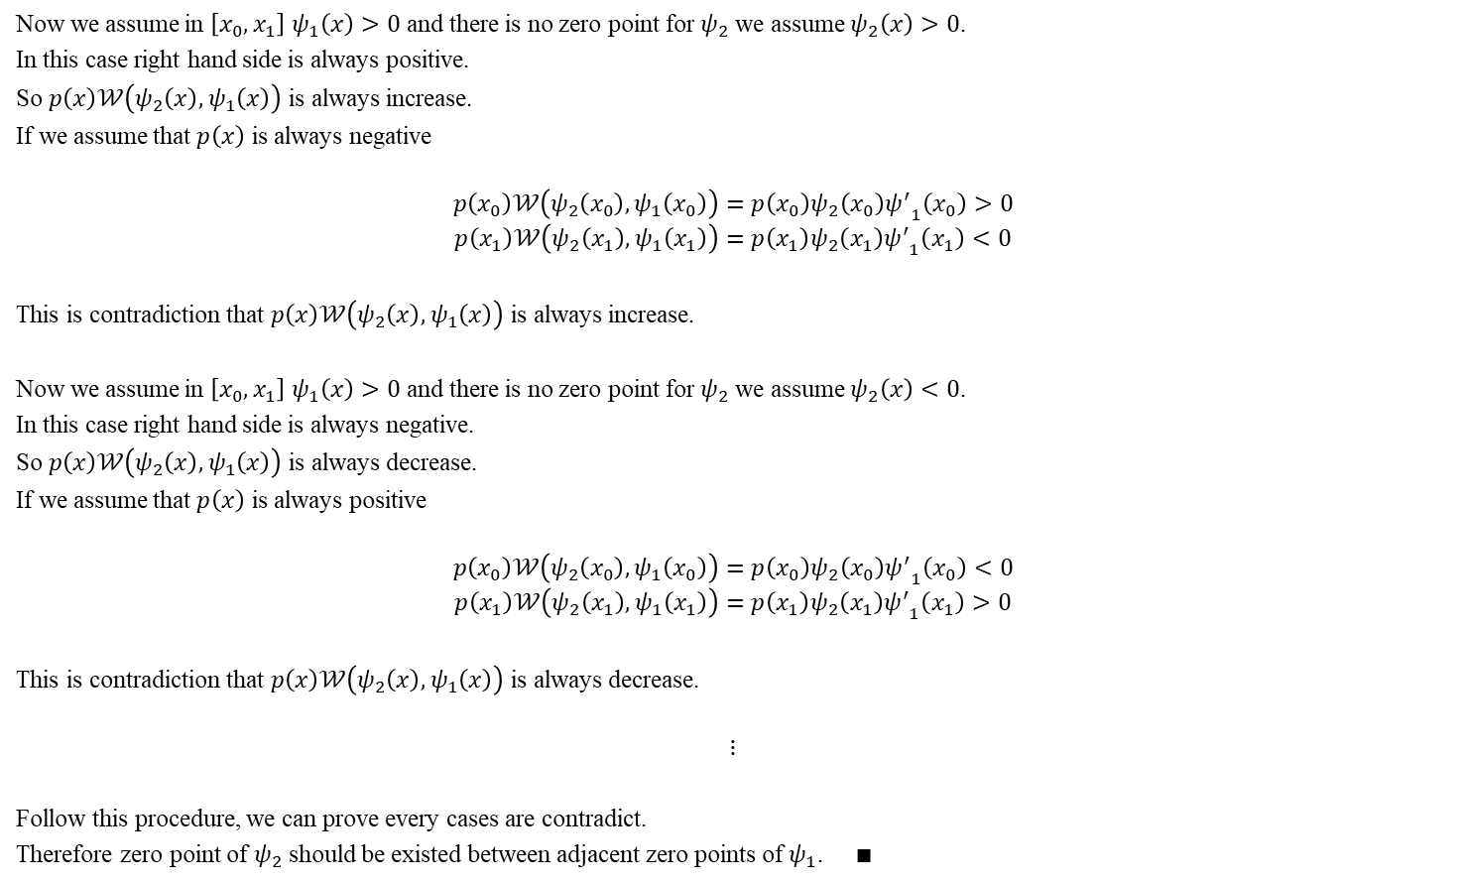
Strum’s Comparison Theorem
Now we assume in $\left[x_{0},x_{1}\right]$ $ψ_{1}\left(x\right)>0$ and there is no zero point for $ψ_{2}$ we assume $ψ_{2}\left(x\right)>0$.
In this case right hand side is always positive.
So $p\left(x\right)𝒲\left(ψ_{2}\left(x\right),ψ_{1}\left(x\right)\right)$ is always increase.
If we assume that $p\left(x\right)$ is always negative
$$p\left(x_{0}\right)𝒲\left(ψ_{2}\left(x_{0}\right),ψ_{1}\left(x_{0}\right)\right)=p\left(x_{0}\right)ψ_{2}\left(x_{0}\right){ψ^{′}}_{1}\left(x_{0}\right)>0$$
$$p\left(x_{1}\right)𝒲\left(ψ_{2}\left(x_{1}\right),ψ_{1}\left(x_{1}\right)\right)=p\left(x_{1}\right)ψ_{2}\left(x_{1}\right){ψ^{′}}_{1}\left(x_{1}\right)<0$$
This is contradiction that $p\left(x\right)𝒲\left(ψ_{2}\left(x\right),ψ_{1}\left(x\right)\right)$ is always increase.
Now we assume in $\left[x_{0},x_{1}\right]$ $ψ_{1}\left(x\right)>0$ and there is no zero point for $ψ_{2}$ we assume $ψ_{2}\left(x\right)<0$.
In this case right hand side is always negative.
So $p\left(x\right)𝒲\left(ψ_{2}\left(x\right),ψ_{1}\left(x\right)\right)$ is always decrease.
If we assume that $p\left(x\right)$ is always positive
$$p\left(x_{0}\right)𝒲\left(ψ_{2}\left(x_{0}\right),ψ_{1}\left(x_{0}\right)\right)=p\left(x_{0}\right)ψ_{2}\left(x_{0}\right){ψ^{′}}_{1}\left(x_{0}\right)<0$$
$$p\left(x_{1}\right)𝒲\left(ψ_{2}\left(x_{1}\right),ψ_{1}\left(x_{1}\right)\right)=p\left(x_{1}\right)ψ_{2}\left(x_{1}\right){ψ^{′}}_{1}\left(x_{1}\right)>0$$
This is contradiction that $p\left(x\right)𝒲\left(ψ_{2}\left(x\right),ψ_{1}\left(x\right)\right)$ is always decrease.
$$⋮$$
Follow this procedure, we can prove every cases are contradict.
Therefore zero point of $ψ_{2}$ should be existed between adjacent zero points of $ψ_{1}$. $∎$

Slide 24
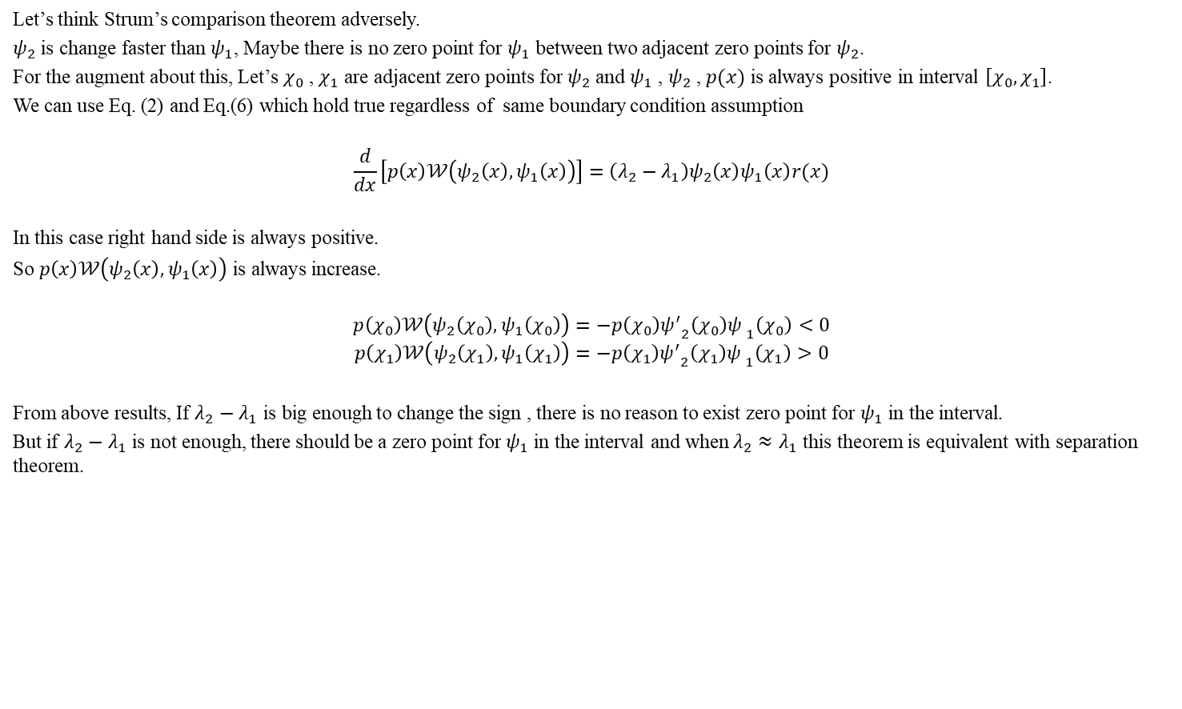
Strum’s Comparison Theorem
Let’s think Strum’s comparison theorem adversely.
$ψ_{2}$ is change faster than $ψ_{1}$, Maybe there is no zero point for $ψ_{1}$ between two adjacent zero points for $ψ_{2}$.
For the augment about this, Let’s $χ_{0}$ , $χ_{1}$ are adjacent zero points for $ψ_{2}$ and $ψ_{1}$ , $ψ_{2}$ , $p(x)$ is always positive in interval $\left[χ_{0},χ_{1}\right]$.
We can use Eq. (2) and Eq.(6) which hold true regardless of same boundary condition assumption
$$\frac{d}{dx}\left[p\left(x\right)𝒲\left(ψ_{2}\left(x\right),ψ_{1}\left(x\right)\right)\right]=\left(λ_{2}−λ_{1}\right)ψ_{2}\left(x\right)ψ_{1}\left(x\right)r(x)$$
In this case right hand side is always positive.
So $p\left(x\right)𝒲\left(ψ_{2}\left(x\right),ψ_{1}\left(x\right)\right)$ is always increase.
$$p\left(χ_{0}\right)𝒲\left(ψ_{2}\left(χ_{0}\right),ψ_{1}\left(χ_{0}\right)\right)=−p\left(χ_{0}\right){ψ^{′}}_{2}\left(χ_{0}\right){ψ^{ }}_{1}\left(χ_{0}\right)<0$$
$$p\left(χ_{1}\right)𝒲\left(ψ_{2}\left(χ_{1}\right),ψ_{1}\left(χ_{1}\right)\right)=−p\left(χ_{1}\right){ψ^{′}}_{2}\left(χ_{1}\right){ψ^{ }}_{1}\left(χ_{1}\right)>0$$
From above results, If $λ_{2}−λ_{1}$ is big enough to change the sign , there is no reason to exist zero point for $ψ_{1}$ in the interval.
But if $λ_{2}−λ_{1}$ is not enough, there should be a zero point for $ψ_{1}$ in the interval and when $λ_{2}≈λ_{1}$ this theorem is equivalent with separation theorem.

Slide 25

Strum’s Oscillation Theorem
It have proposition that eigenfunction for Strum-Liouville differential equation with same regular boundary condition is always satisfied
$$N\left(λ_{n+1}\right)=N\left(λ_{n}\right)+1$$
$$λ_{0}<λ_{1}<…<λ_{n}<…,\lim_{n→∞}{λ_{n}}=0$$
Here, $N(λ)$ is a number of zero points of $ψ$.
[Proof]
Let zero points for $ψ_{n}$ as $a<x_{0}<…<x_{m}<b$.
We assume that $ψ_{n}$ and $ψ_{m}$ are positive value at the interval $\left[a,x_{0}\right]$.
When $k>n$ , Let $ψ_{k}$ has no zero point in the $\left[a,x_{0}\right]$
To avoid meaningless regular boundary condition.
$$\left[\begin{matrix}ψ_{k}(a) & ψ_{n}(a) \\ {ψ′}_{k}(a) & {ψ′}_{n}(a)\end{matrix}\right]\left({α \atop α′}\right)=\left({0 \atop 0}\right)$$
$$⇒𝒲\left[ψ_{k}\left(a\right),ψ_{n}\left(a\right)\right]=0$$
We can also use Eq. (2) and Eq.(6)
$$\frac{d}{dx}\left[p\left(x\right)𝒲\left(ψ_{k}\left(x\right),ψ_{n}\left(x\right)\right)\right]=\left(λ_{k}−λ_{n}\right)ψ_{k}\left(x\right)ψ_{n}\left(x\right)r(x)$$

Slide 26
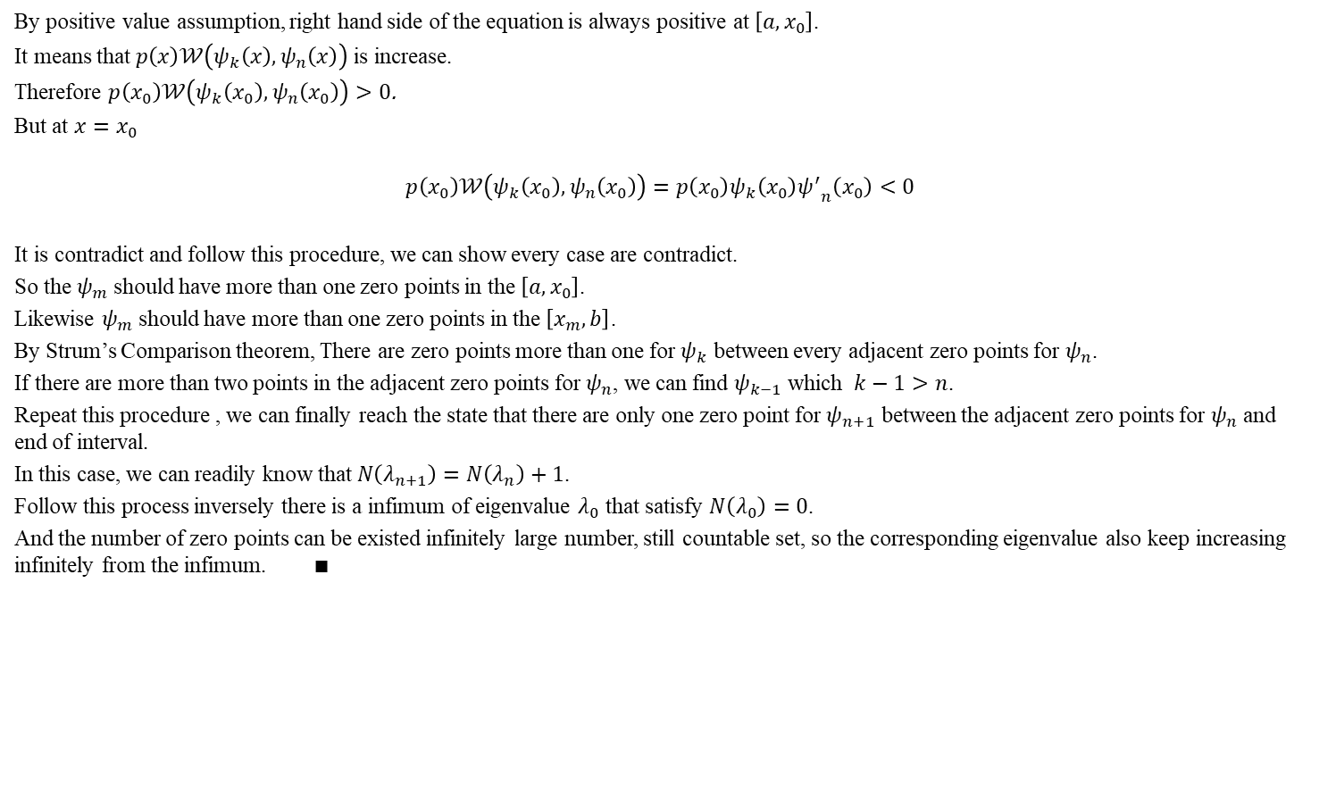
Strum’s Oscillation Theorem
By positive value assumption, right hand side of the equation is always positive at $\left[a,x_{0}\right]$.
It means that $p\left(x\right)𝒲\left(ψ_{k}\left(x\right),ψ_{n}\left(x\right)\right)$ is increase.
Therefore $p\left(x_{0}\right)𝒲\left(ψ_{k}\left(x_{0}\right),ψ_{n}\left(x_{0}\right)\right)>0$.
But at $x=x_{0}$
$$p\left(x_{0}\right)𝒲\left(ψ_{k}\left(x_{0}\right),ψ_{n}\left(x_{0}\right)\right)=p\left(x_{0}\right)ψ_{k}\left(x_{0}\right){ψ^{′}}_{n}\left(x_{0}\right)<0$$
It is contradict and follow this procedure, we can show every case are contradict.
So the $ψ_{m}$ should have more than one zero points in the $\left[a,x_{0}\right]$.
Likewise $ψ_{m}$ should have more than one zero points in the $\left[x_{m},b\right]$.
By Strum’s Comparison theorem, There are zero points more than one for $ψ_{k}$ between every adjacent zero points for $ψ_{n}$.
If there are more than two points in the adjacent zero points for $ψ_{n}$, we can find $ψ_{k−1}$ which $k−1>n$.
Repeat this procedure , we can finally reach the state that there are only one zero point for $ψ_{n+1}$ between the adjacent zero points for $ψ_{n}$ and end of interval.
In this case, we can readily know that $N\left(λ_{n+1}\right)=N\left(λ_{n}\right)+1$.
Follow this process inversely there is a infimum of eigenvalue $λ_{0}$ that satisfy $N\left(λ_{0}\right)=0$.
And the number of zero points can be existed infinitely large number, still countable set, so the corresponding eigenvalue also keep increasing infinitely from the infimum. $∎$

Slide 27

Completeness of Eigenfunctions
We consider square-integrable function $f$.
Let $ψ_{m}$ is a orthonormal eigenfunction corresponding eigenvalue $λ_{m}$.
Define partial sum $S_{m}$
$$S_{m}\left(x\right)≡\sum_{k=0}^{m}{a_{k}ψ_{k}\left(x\right)} ,a_{k}=<f,ψ_{k}>$$
Then following relation is always satisfied
$$\lim_{m→∞}{{\left|f\left(x\right)−S_{m}\left(x\right)\right|}^{2}=0}$$
It means every square-integrable function can be expressed by infinite sum of orthonormal eigenfunction.
Here we define inner product and orthonormal eigenfunction using Kronecker delta $δ$ as follow
$$\left\langle f\left(x\right),g(x)\right\rangle =\int_{a}^{b}{f^{∗}(x)g(x)r(x)}dx$$
$$\left\langle ψ_{m}(x),ψ_{n}(x)\right\rangle =δ_{mn}$$

Slide 28
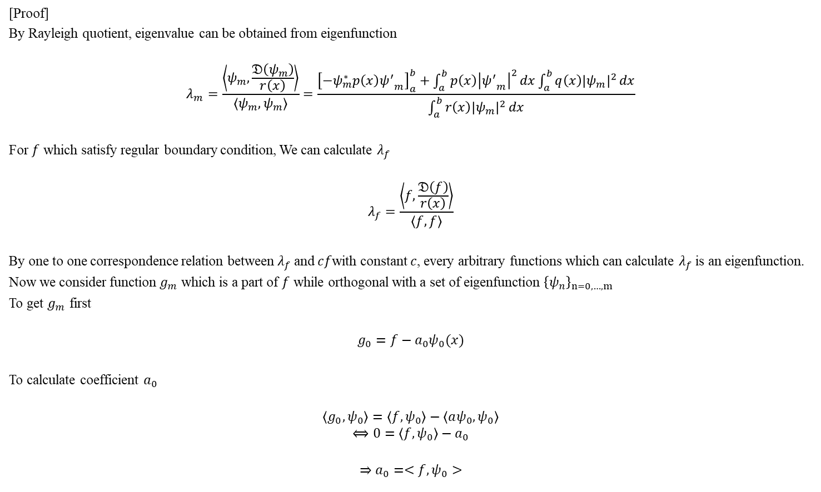
Completeness of Eigenfunctions
[Proof]
By Rayleigh quotient, eigenvalue can be obtained from eigenfunction
$$λ_{m}=\frac{\left\langle ψ_{m},\frac{𝔇\left(ψ_{m}\right)}{r\left(x\right)}\right\rangle }{\left\langle ψ_{m},ψ_{m}\right\rangle }=\frac{{\left[−ψ_{m}^{∗}p\left(x\right){ψ^{′}}_{m}\right]}_{a}^{b}+\int_{a}^{b}{p\left(x\right){\left|{ψ^{′}}_{m}\right|}^{2}}dx\int_{a}^{b}{q\left(x\right){\left|ψ_{m}\right|}^{2}}dx}{\int_{a}^{b}{r\left(x\right){\left|ψ_{m}\right|}^{2}}dx}$$
For $f$ which satisfy regular boundary condition, We can calculate $λ_{f}$
$$λ_{f}=\frac{\left\langle f,\frac{𝔇\left(f\right)}{r\left(x\right)}\right\rangle }{\left\langle f,f\right\rangle }$$
By one to one correspondence relation between $λ_{f}$ and $cf$with constant $c$, every arbitrary functions which can calculate $λ_{f}$ is an eigenfunction.
Now we consider function $g_{m}$ which is a part of $f$ while orthogonal with a set of eigenfunction ${\left\{ψ_{n}\right\}}_{n=0,…,m}$
To get $g_{m}$ first
$$g_{0}=f−a_{0}ψ_{0}(x)$$
To calculate coefficient $a_{0}$
$$\left\langle g_{0},ψ_{0}\right\rangle =\left\langle f,ψ_{0}\right\rangle −\left\langle aψ_{0},ψ_{0}\right\rangle$$
$$⟺0=\left\langle f,ψ_{0}\right\rangle −a_{0}$$
$$⇒a_{0}=<f,ψ_{0}>$$

Slide 29

Completeness of Eigenfunctions
In the same way
$$g_{m}=f−a_{0}ψ_{0}\left(x\right)−…−a_{m}ψ_{m}\left(x\right)$$
$$⟺g_{m}=f−S_{m}(x)$$
$$⇒a_{m}=<f,ψ_{m}>$$
$g_{m}$ have a corresponding eigenvalue $λ_{gm}$ because it is a also square-integrable function.
If we take inner product with $ψ_{k}$ which $k≤m$
$$\left\langle g_{m},ψ_{k}\right\rangle =\left\langle f,ψ_{k}\right\rangle −\left\langle S_{m},ψ_{k}\right\rangle$$
$$⟺\left\langle g_{m},ψ_{k}\right\rangle =\left\langle f,ψ_{k}\right\rangle −a_{k}$$
$$⟺\left\langle g_{m},ψ_{k}\right\rangle =0$$
It means $g_{m}$ is an eigenfunction that consist of element of a set ${\left\{ψ_{k}\right\}}_{k=m+1,m+2,..}$ .
Therefore eigenvalue for $g_{m}$ have infimum $λ_{m+1}≤λ_{g_{m}}$.
It shows a function that eliminated certain eigenfunction can’t have a eigenvalue corresponding to eliminated eigenfunction.
To analyze the meaning of $λ_{gm}$ using Rayleigh quotient
$$λ_{gm}=\frac{\left\langle g_{m},\frac{𝔇\left(g_{m}\right)}{r\left(x\right)}\right\rangle }{\left\langle g_{m},g_{m}\right\rangle }$$

Slide 30

Completeness of Eigenfunctions
First let’s consider inner product in numerator.
By linearity of operator $𝔇$
$$\left\langle g_{m},\frac{𝔇\left(g_{m}\right)}{r\left(x\right)}\right\rangle =\left\langle f−S_{m},\frac{𝔇\left(f−S_{m}\right)}{r\left(x\right)}\right\rangle =\left\langle f−S_{m},\frac{𝔇\left(f\right)−𝔇(S_{m})}{r\left(x\right)}\right\rangle$$
$$⇒\left\langle g_{m},\frac{𝔇\left(g_{m}\right)}{r\left(x\right)}\right\rangle =\left\langle f,\frac{𝔇\left(f\right)}{r\left(x\right)}\right\rangle −2\left\langle f,\frac{𝔇\left(S_{m}\right)}{r\left(x\right)}\right\rangle +\left\langle S_{m},\frac{𝔇\left(S_{m}\right)}{r\left(x\right)}\right\rangle$$
The second term of right hand side is
$$\left\langle f,\frac{𝔇\left(S_{m}\right)}{r\left(x\right)}\right\rangle =\int_{a}^{b}{f^{∗}𝔇(S_{m})}dx=\int_{a}^{b}{{\left(g_{m}+S_{m}\right)}^{∗}𝔇(S_{m})}dx=\int_{a}^{b}{{\left(g_{m}+S_{m}\right)}^{∗}\left[𝔇\left(a_{0}ψ_{0})+…+𝔇(a_{m}ψ_{m}\right)\right]}dx$$
Using relation between eigenvalue and operator $𝔇$
$$\int_{a}^{b}{{\left(g_{m}+S_{m}\right)}^{∗}𝔇\left(a_{0}ψ_{0}\right)}dx=λ_{0}a_{0}\int_{a}^{b}{{\left(g_{m}+S_{m}\right)}^{∗}ψ_{0}r}dx=λ_{0}a_{0}\left(\left\langle g_{m},ψ_{0}\right\rangle +\left\langle S_{m},ψ_{0}\right\rangle \right)=λ_{0}a_{0}\left(0+a_{0}^{∗}\right)=λ_{0}{\left|a_{0}\right|}^{2}$$
$$⇒\left\langle f,\frac{𝔇\left(S_{m}\right)}{r\left(x\right)}\right\rangle =\sum_{k=0}^{m}{λ_{k}{\left|a_{k}\right|}^{2}}$$
(9)

Slide 31

Completeness of Eigenfunctions
In the same way last term is
$$∴ \left\langle S_{m},\frac{𝔇\left(S_{m}\right)}{r\left(x\right)}\right\rangle =\sum_{k=0}^{m}{λ_{k}{\left|a_{k}\right|}^{2}}$$
Substitute into Eq. (9)
$$\left\langle g_{m},\frac{𝔇\left(g_{m}\right)}{r\left(x\right)}\right\rangle =\left\langle f,\frac{𝔇\left(f\right)}{r\left(x\right)}\right\rangle −\sum_{k=0}^{m}{λ_{k}{\left|a_{k}\right|}^{2}}$$
Now let’s consider inner product in denominator.
$$\left\langle g_{m},g_{m}\right\rangle =\left\langle f−S_{m},f−S_{m}\right\rangle =\int_{a}^{b}{{\left|f−S_{m}\right|}^{2}r}dx=E_{m}$$
It is magnitude of gap between arbitrary function $f$ and summation of eigenfunction $s_{m}$.

Slide 32

Completeness of Eigenfunctions
Rewrite the eigenvalue
$$λ_{gm}=\frac{1}{E_{m}}\left(\left\langle f,\frac{𝔇\left(f\right)}{r\left(x\right)}\right\rangle −\sum_{k=0}^{m}{λ_{k}{\left|a_{k}\right|}^{2}}\right)$$
$$⇔E_{m}=\frac{1}{λ_{gm}}\left(\left\langle f,\frac{𝔇\left(f\right)}{r\left(x\right)}\right\rangle −\sum_{k=0}^{m}{λ_{k}{\left|a_{k}\right|}^{2}}\right)$$
Let $m_{0}$ is a point that $λ_{m_{0}}<0≤λ_{m_{0}+1}$
$$E_{m}≤\frac{1}{λ_{gm}}\left(\left\langle f,\frac{𝔇\left(f\right)}{r\left(x\right)}\right\rangle −\sum_{k=0}^{m_{0}}{λ_{k}{\left|a_{k}\right|}^{2}}\right)$$
$E_{m}$ is positive value and infimum of $λ_{gm}$
$$0≤E_{m}≤\frac{1}{λ_{m+1}}\left(\left\langle f,\frac{𝔇\left(f\right)}{r\left(x\right)}\right\rangle −\sum_{k=0}^{m_{0}}{λ_{k}{\left|a_{k}\right|}^{2}}\right)$$

Slide 33
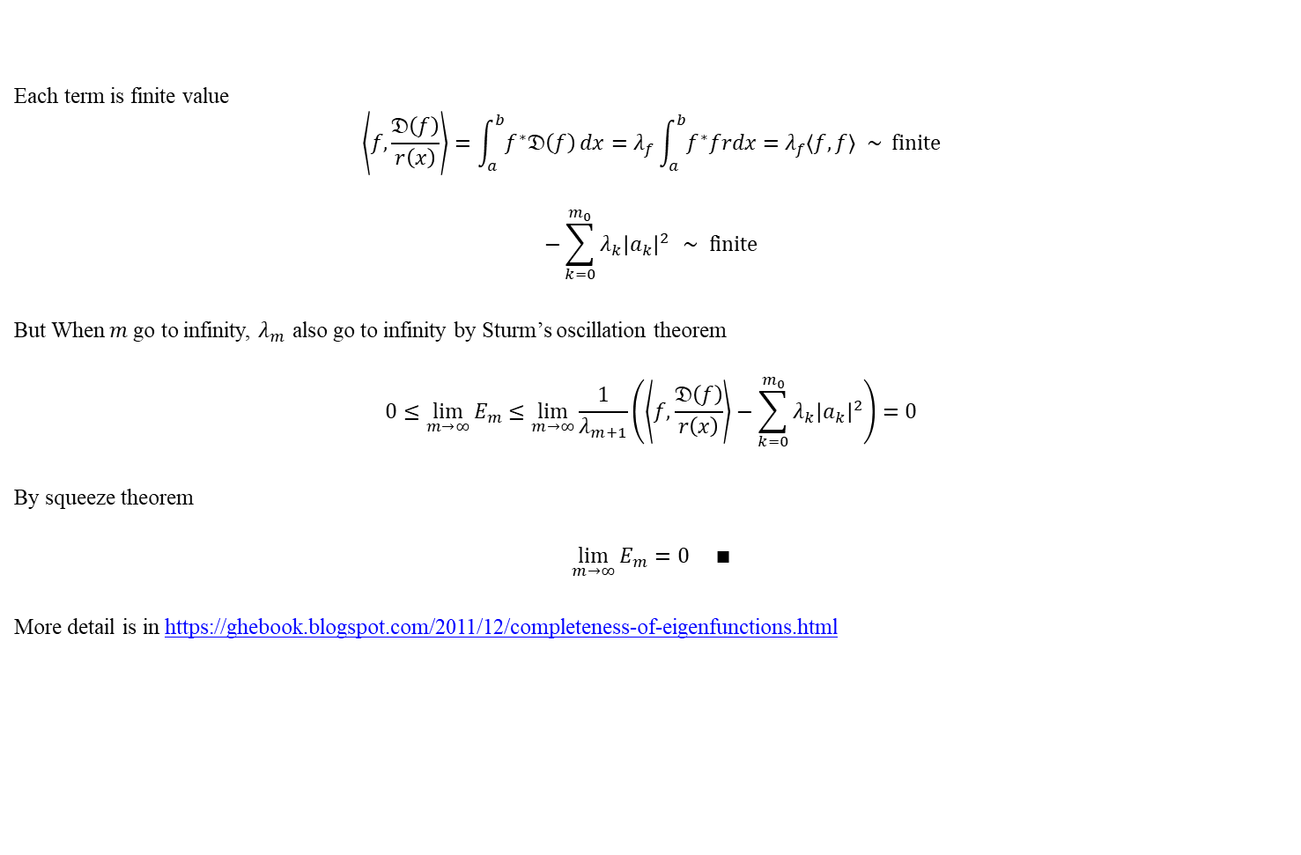
Completeness of Eigenfunctions
Each term is finite value
$$\left\langle f,\frac{𝔇\left(f\right)}{r\left(x\right)}\right\rangle =\int_{a}^{b}{f^{∗}𝔇\left(f\right)}dx=λ_{f}\int_{a}^{b}{f^{∗}frdx}=λ_{f}\left\langle f,f\right\rangle \sim finite$$
$$−\sum_{k=0}^{m_{0}}{λ_{k}{\left|a_{k}\right|}^{2}} \sim finite$$
But When $m$ go to infinity, $λ_{m}$ also go to infinity by Sturm’s oscillation theorem
$$0≤\lim_{m→∞}{E_{m}}≤\lim_{m→∞}\frac{1}{λ_{m+1}}\left(\left\langle f,\frac{𝔇\left(f\right)}{r\left(x\right)}\right\rangle −\sum_{k=0}^{m_{0}}{λ_{k}{\left|a_{k}\right|}^{2}}\right)=0$$
By squeeze theorem
$$\lim_{m→∞}{E_{m}}=0 ∎$$
More detail is in https://ghebook.blogspot.com/2011/12/completeness-of-eigenfunctions.html

Slide 34

Appendix 1
For $ψ_{m}$, the regular boundary condition is
$$αψ_{m}\left(a\right)+α^{′}{ψ′}_{m}\left(a\right)=0$$
Take complex conjugate
$$α^{∗}ψ_{m}^{∗}\left(a\right)+{\left(α^{′}\right)}^{∗}{\left({ψ^{′}}_{m}\right)}^{∗}\left(a\right)=0$$
$$∴{\left({ψ^{′}}_{m}\right)}^{∗}\left(a\right)=−\frac{{ α}^{∗}ψ_{m}^{∗}\left(a\right)}{{\left(α^{′}\right)}^{∗}}$$
For $ψ_{m}^{∗}$, the regular boundary condition is
$$αψ_{m}^{∗}\left(a\right)+α^{′}{\left(ψ_{m}^{∗}\right)}^{′}\left(a\right)=0$$
Substitute Eq. (9) into boundary condition for $ψ_{m}^{∗}$ with the relation ${\left({ψ^{′}}_{m}\right)}^{∗}(x)={\left(ψ_{m}^{∗}\right)}^{′}\left(x\right)$
$$αψ_{m}^{∗}\left(x\right)−\frac{{ α}^{∗}ψ_{m}^{∗}\left(a\right)}{{\left(α^{′}\right)}^{∗}}α^{′}=\left[α{\left(α^{′}\right)}^{∗}−{ α}^{∗}α^{′}\right]\frac{ψ_{m}^{∗}\left(a\right)}{{\left(α^{′}\right)}^{∗}}=0$$
It means $α{\left(α^{′}\right)}^{∗}−{ α}^{∗}α^{′}=0$ and it says $α{\left(α^{′}\right)}^{∗}$ is real value.
$$Im\left[α{\left(α^{′}\right)}^{∗}\right]=0$$
It is a additional condition for Real eigenvalue.
(9)

